Slide 1

Hiring Process Analytics
Data Analysis Project
Deepthy A
Trainity Data Analytic Trainee

Slide 2
Project Description
Objective: To analyze the hiring process data of a multinational company, uncover trends in hiring, salary, departmental distribution, and provide insights that can improve HR practices.
Dataset: Historical hiring records, including gender, salary, job titles, departments, etc.

Slide 3

Introduction
The Hiring Process Analytics project aims to analyze recruitment-related data to identify key insights and trends in hiring practices.
This includes evaluating salary distributions, gender-based hiring patterns, average offered salaries, departmental hiring counts, and position tier distributions.
Data cleaning and preprocessing were performed in Power Query, followed by analysis using pivot tables and visualizations in Excel.

Slide 4
Tech-Stack Used
Microsoft Excel 365
Used for data cleaning, statistical computation, visualization (pivot tables, charts, etc.)
Microsoft Powerpoint 365
Used for creating report.

Slide 5

Data Analytics Tasks
Hiring Analysis: The hiring process involves bringing new individuals into the organization for various roles.
Your Task: Determine the gender distribution of hires. How many males and females have been hired by the company?
Salary Analysis: The average salary is calculated by adding up the salaries of a group of employees and then dividing the total by the number of employees.
Your Task: What is the average salary offered by this company? Use Excel functions to calculate this.

Slide 6
Data Analytics Tasks
Salary Distribution: Class intervals represent ranges of values, in this case, salary ranges. The class interval is the difference between the upper and lower limits of a class.
Your Task: Create class intervals for the salaries in the company. This will help you understand the salary distribution.
Departmental Analysis: Visualizing data through charts and plots is a crucial part of data analysis.
Your Task: Use a pie chart, bar graph, or any other suitable visualization to show the proportion of people working in different departments.
Position Tier Analysis: Different positions within a company often have different tiers or levels.
Your Task: Use a chart or graph to represent the different position tiers within the company. This will help you understand the distribution of positions across different tiers.

Slide 7
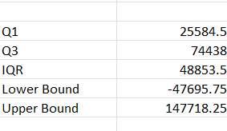
Data Cleaning and Preprocessing
All data cleaning steps were conducted using Power Query:
Removed duplicate rows.
Handled null values by replacing or filtering them appropriately.
Standardized column names and data types.
Created conditional columns for status-based filtering.
Applied outlier detection for salary using the IQR method:
Calculated Q1 and Q3.
Computed IQR = Q3 - Q1.
Filtered out salaries below Q1 - 1.5IQR or above Q3 + 1.5IQR.

Slide 8
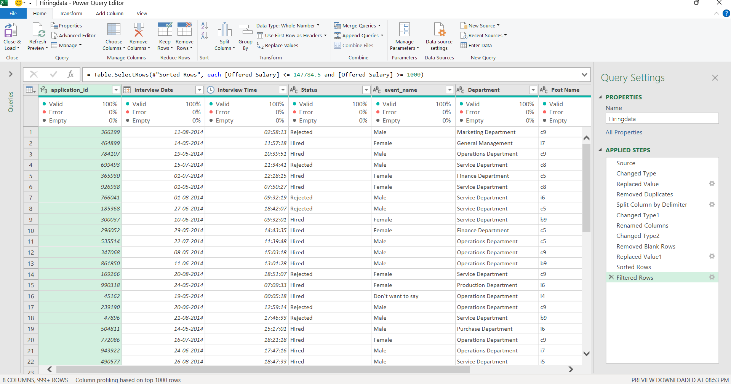

Slide 9
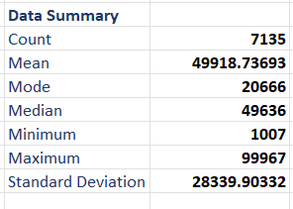
Descriptive Statistics
These statistics provide an overview of the salary range and its variability in the dataset.

Slide 10
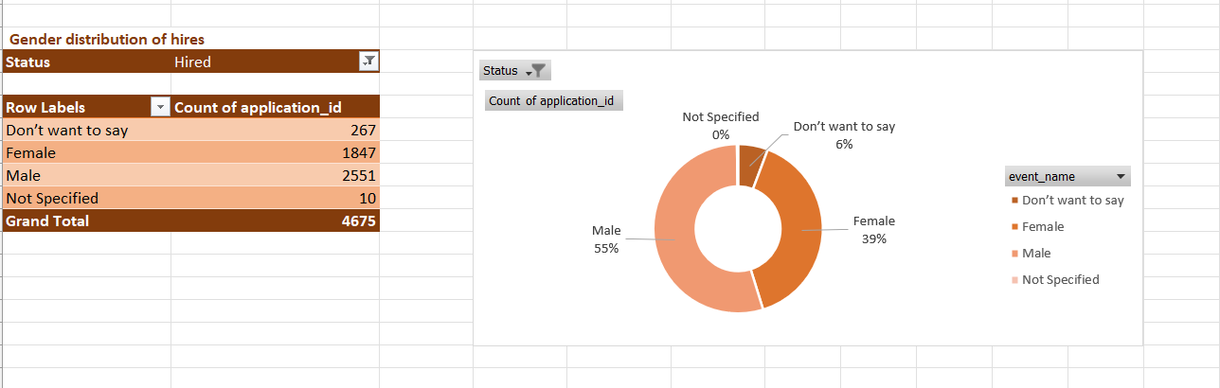
Gender Distribution of Hires
Male: 55%
Female: 39%
Others/Not specified: 6%
The organization has a male-dominant hiring pattern. The share of female hires is significant but lags behind.

Slide 11
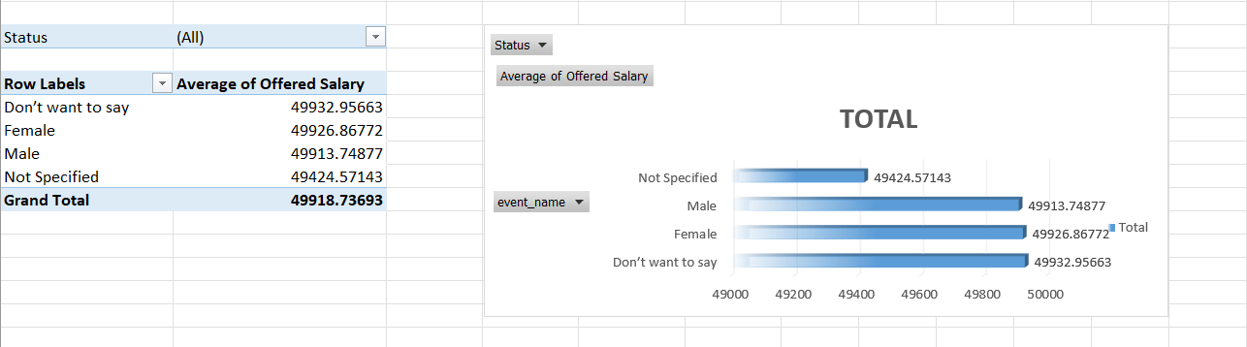
Average Salary by Gender
Average offered salary is quite consistent across gender identities.
Slight variation (~₹20–₹30 difference), which is negligible statistically.
Suggests no obvious gender-based bias in salary offers, which is a positive sign for equitable pay practices.

Slide 12
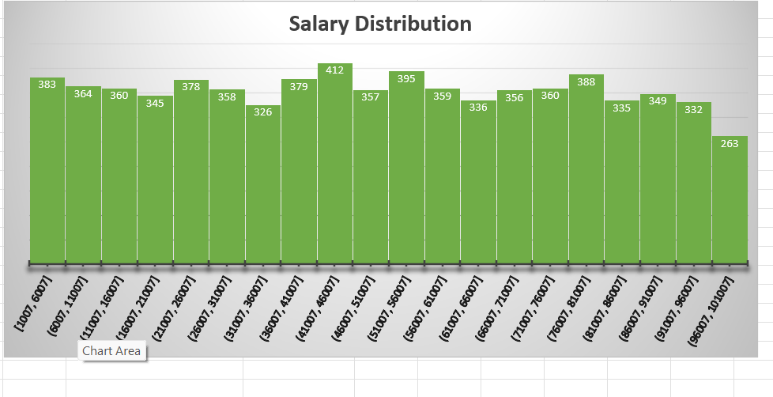
Salary Distribution
Most of the offered salaries fall within the ₹40,007–₹60,007 range, with peaks around ₹46,007–₹50,007 and ₹50,007–₹56,007.
The salary distribution is relatively even with a slight peak in the mid-ranges. There’s a steep drop in the ₹96,007–₹1,00,007 bracket, indicating fewer high-end offers.

Slide 13
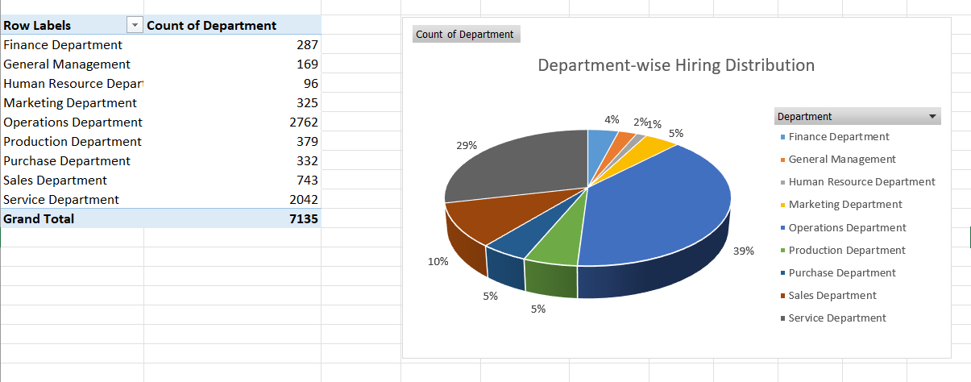
Department-Wise Hiring
Top Departments:
Operations (39%)
Service (29%)
Other departments like Sales (10%), Production (5%) follow behind.
Operations and Service dominate the hiring, likely indicating company focus areas or workforce needs..

Slide 14
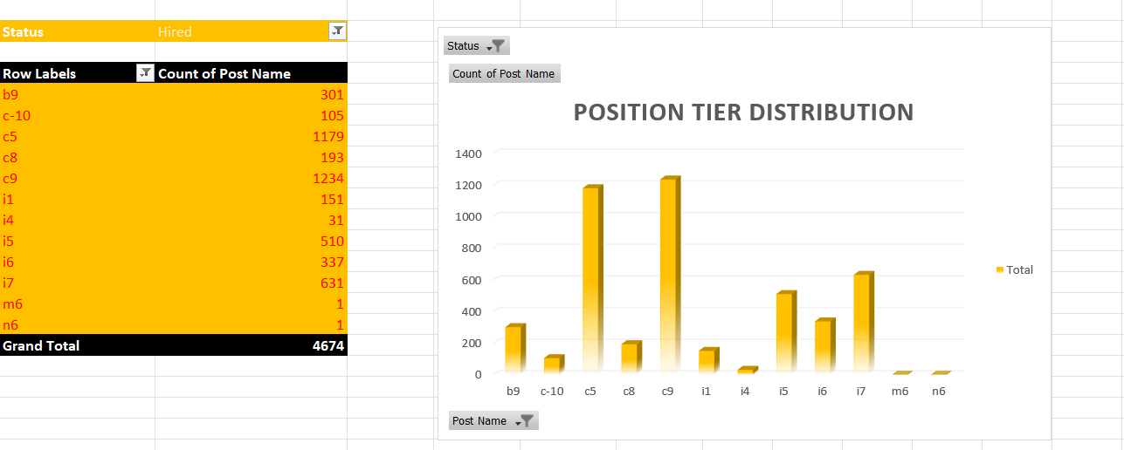
Position Tier Distribution
Most common roles: c5 (1179), c9 (1234), i7 (631)
Some tiers (m6, n6) have minimal hires, suggesting rare or special positions.
Clear hiring focus on a few select tiers. You could further explore job responsibilities per tier in the full report.

Slide 15

Conclusion
This analysis highlights key aspects of the hiring process.
The company focuses majorly on operational roles with balanced salary offerings across genders.
A few tiers dominate the hiring pattern, indicating preferred positions or recurring needs.
These insights can guide recruitment strategy and workforce planning.
Drive Link: https://docs.google.com/spreadsheets/d/1KDuSkzg2JgkgjVab0P8_rZVifzMxmlB6/edit?usp=sharing&ouid=112959782025131466050&rtpof=true&sd=true

